Slide 1
Efficient parameterized string matching
Kimmo Fredriksson and Maxim Mozgovoy
Information Processing Letters, Vol. 100, pp. 91-96, 2006
Speaker: Chia-Hung Chang
Date: May 16, 2007

Slide 2
Abstrct
In parameterized string matching the pattern P matches a substring t of the text T if there exist a bijective mapping from the symbols of P to the symbols of t . We give simple and practical algorithms for finding all such pattern occurrences in sublinear time on average. The algorithms work for a single and multiple patterns.

Slide 3
Introduction
Parameterized string match
  The symbols from Σ must match exactly
  The symbols from Λ can be renamed

Slide 4
Preliminaries
Σ ={A,B}
Λ ={X,Y,Z}
P = AAZYZABXYZAX
prev(P ) = AA002AB055A4
An auxiliary array prv

Slide 5


Slide 6
shift or example(1)
D<<1 | 1 | 1 | 1 | 1 | 0
B[d] | 1 | 1 | 1 | 1 | 1
D’ | 1 | 1 | 1 | 1 | 1
t | d | a | b | c | a | b | c | a
p | a | b | c | a | b
D<<1 | 1 | 1 | 1 | 1 | 0
B[a] | 1 | 0 | 1 | 1 | 0
D’ | 1 | 1 | 1 | 1 | 0
a
b
c
a
b
B[a] | 0 | 1 | 1 | 0 | 1
B[b] | 1 | 0 | 1 | 1 | 0
B[c] | 1 | 1 | 0 | 1 | 1
B[*] | 1 | 1 | 1 | 1 | 1
D<<1 | 1 | 1 | 1 | 0 | 0
B[b] | 0 | 1 | 1 | 0 | 1
D’ | 1 | 1 | 1 | 0 | 1
D<<1 | 1 | 1 | 0 | 1 | 0
B[c] | 1 | 1 | 0 | 1 | 1
D’ | 1 | 1 | 0 | 1 | 1

Slide 7
shift or example(2)
D<<1 | 1 | 0 | 1 | 1 | 0
B[a] | 1 | 0 | 1 | 1 | 0
D’ | 1 | 0 | 1 | 1 | 0
t | d | a | b | c | a | b | c | a
p | a | b | c | a | b
D<<1 | 0 | 1 | 1 | 0 | 0
B[b] | 0 | 1 | 1 | 0 | 1
D’ | 0 | 1 | 1 | 0 | 1
a
b
c
a
b
B[a] | 0 | 1 | 1 | 0 | 1
B[b] | 1 | 0 | 1 | 1 | 0
B[c] | 1 | 1 | 0 | 1 | 1
B[*] | 1 | 1 | 1 | 1 | 1
D<<1 | 1 | 1 | 0 | 1 | 0
B[c] | 1 | 1 | 0 | 1 | 1
D’ | 1 | 1 | 0 | 1 | 1
D<<1 | 1 | 0 | 1 | 1 | 0
B[a] | 1 | 0 | 1 | 1 | 0
D’ | 1 | 0 | 1 | 1 | 0
match

Slide 8
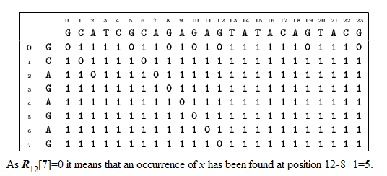
Shift-Or algorithm

Slide 9
Bit-parallel matching
P must be encoded with prev
prev(T [j . . . j + m − 1]) must be maintained in O(1) time per text position
the table B must be built so that all parameterized pattern prefixes can be searched in parallel

Slide 10
Backward trie matching
P = AZBZXBXY
prev(P ) = a0b20b20
Reversed pattern = 02b02b0a
A = {02b02b0a, 02b0a, 0a, 2b02b0a, 2b0a, a, b02b0a, b0a}

Slide 11
Comparision
Single pattern:
  V.S. Boyer-Moore
Multiple matching:
  V.S. Aho-Corasick

Slide 12
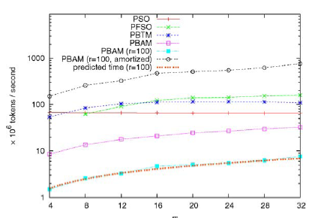
Result

Slide 13
